Slide 1
Chapter 2 - Hydrostatics
CE30460 - Fluid Mechanics
Diogo Bolster

Slide 2
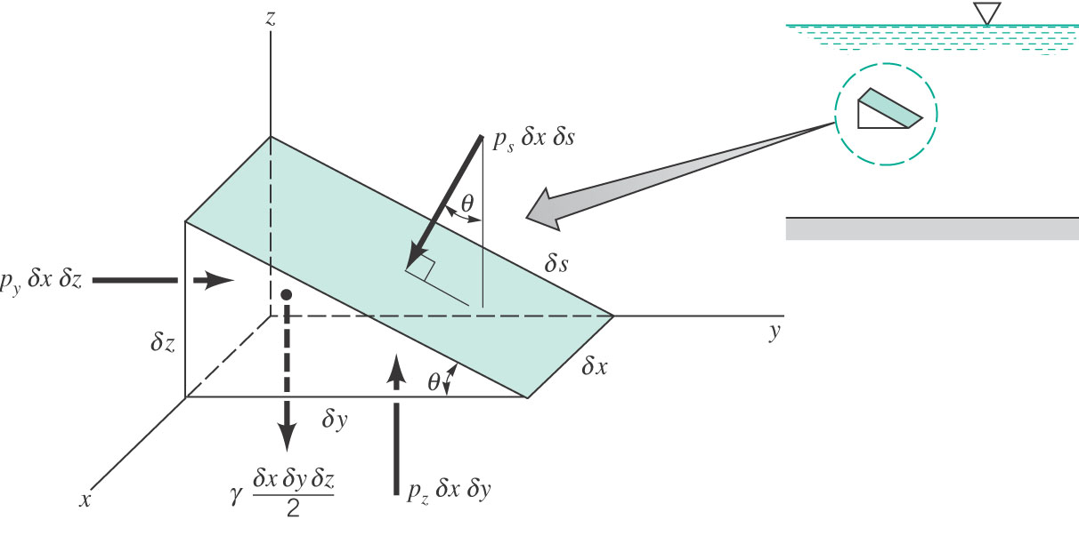
Pressure at a Point Consider the following setup
Conclusion: The pressure at a point in a fluid at rest does not depend on direction
As long as no shearing stresses are present (Pascal’s Law)

Slide 3
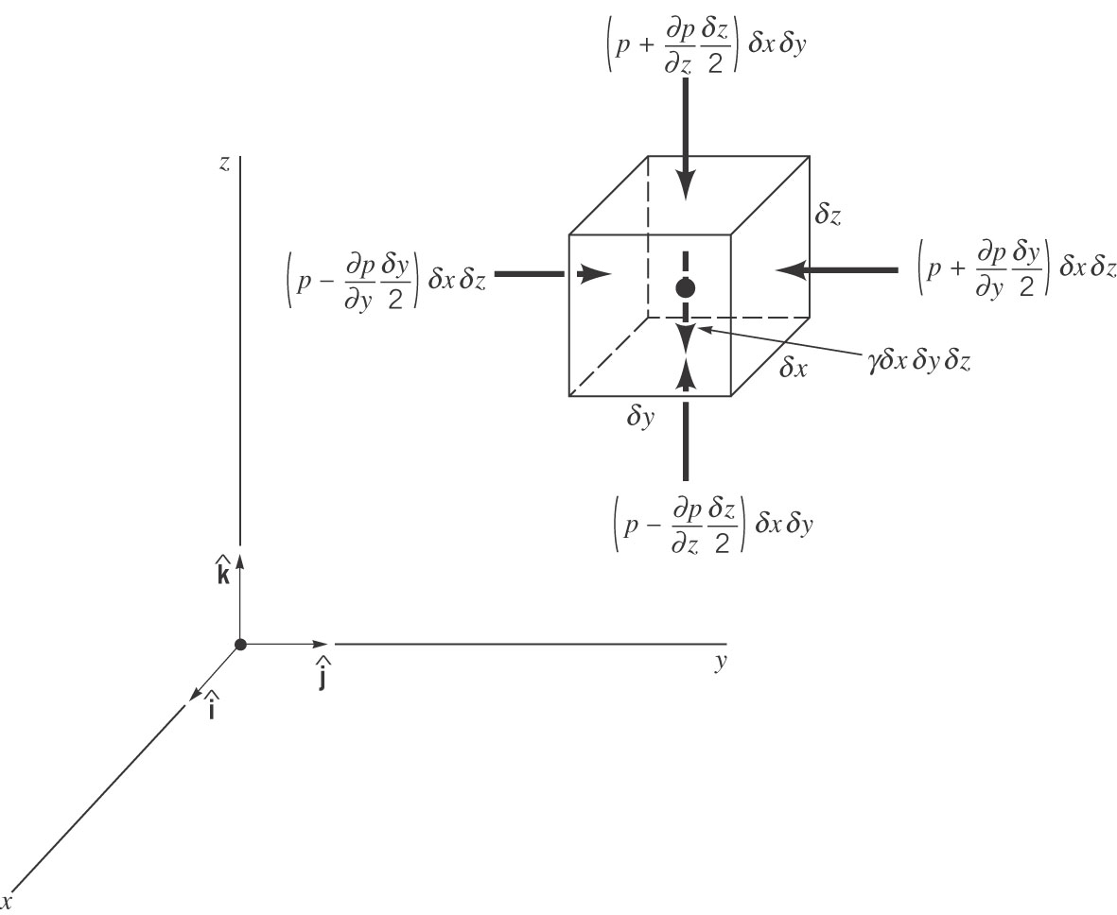
Basic Equation for Pressure Field
Hydrostatic
Recall γ=ρg

Slide 4
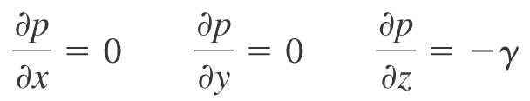
Pressure Variation in a Fluid at Rest

Slide 5
Hydrostatic for different Fluids
Incompressible => Constant Density
Compressible
Isothermal Ideal Gas – p=ρRT
Isentropic p/ρ^{κ}=constant

Slide 6
Sample Problem 1
Determine the change in hydrostatic pressure in a giraffe’s head as it lowers its head from eating leaves 6m above the ground to getting a drink of water at ground level. Assume that blood has the same density as water
Compare this with the pressure of a human heart at 120 mm Hg

Slide 7
Sample Problem 2
In a density stratified lake we measure that the density of the lake varies with depth in a manner that can be approximated by the function
ρ(z)=1000+1.1 z 0<z<100 m
where z=0 is the lake free surface and increases with depth
Determine the pressure field

Slide 8
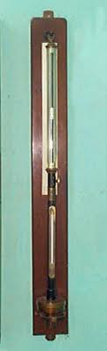
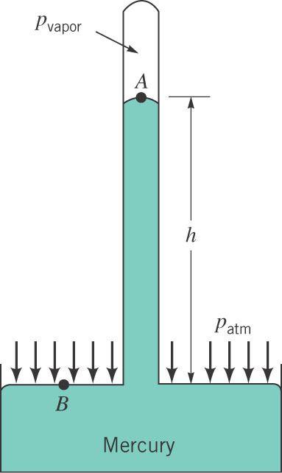
How to measure pressure (Mercury Barometer)
Find a relationship between pressure at
A and at B
Often assume p_{vapor}=0

Slide 9
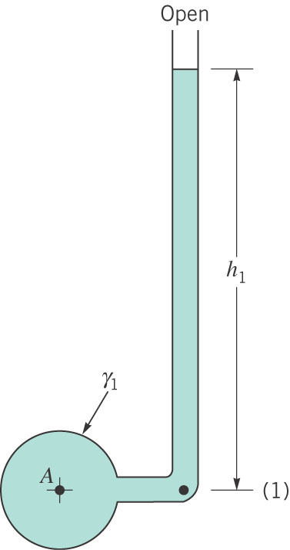
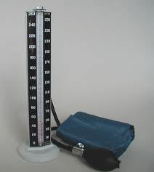
How to measure pressure (Piezometer Tube)

Slide 10
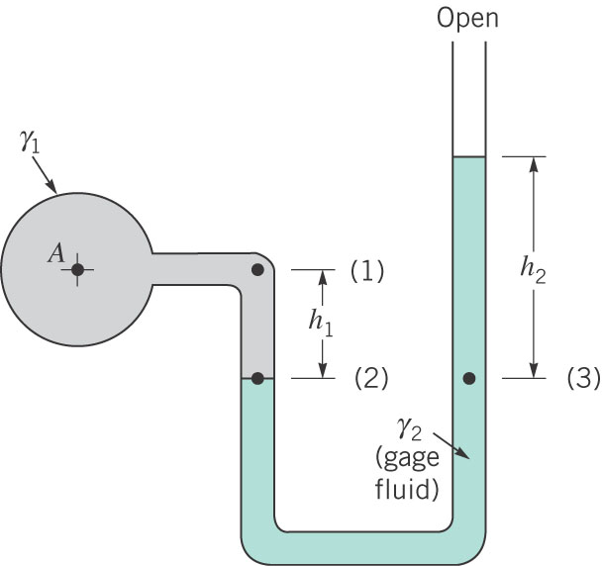
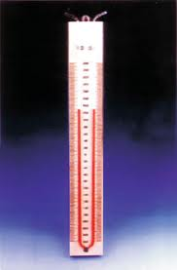
How to measure pressure (U-Tube) Manometer

Slide 11
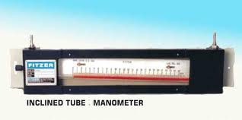
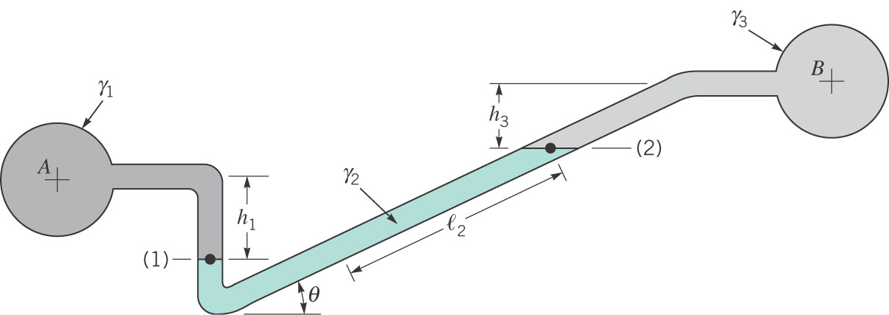
Inclined Manometer
Sensitive to small pressure changes

Slide 12
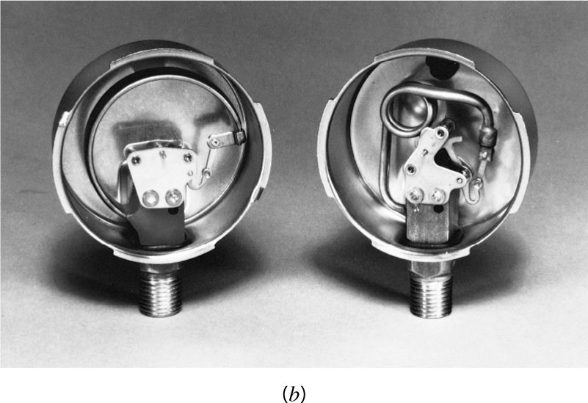
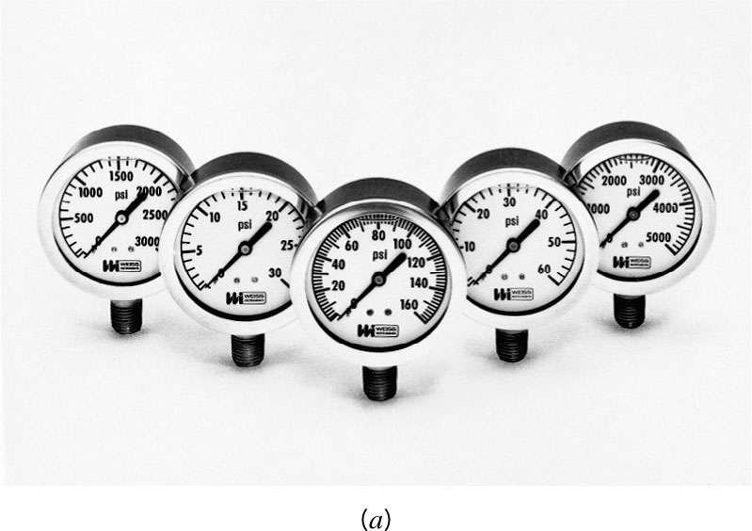
Other Devices

Slide 13
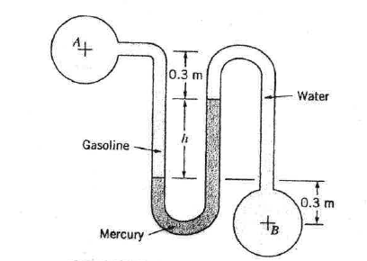
Sample Problem
Pipe A and B are connected. A contains gasoline (SG=0.65) and B water.
Determine differential reading h if A has pressure of 20kPA and B has a vacuum of 150mm Hg.

Slide 14
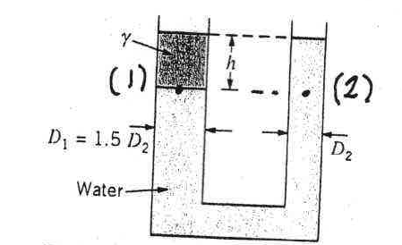
Sample Problem 2
U-shaped tube initially contains only water. A second liquid of specific weight γ (less than water) is placed on top with no mixing. Can the height h be adjusted so that the left and right levels are the same? Proove it.

Slide 15
Hydrostatic Force on a Plane Surface
p=0
p=0
h
What’s the difference in effective force on the bottom vertical surface
and horizontal ones?

Slide 16
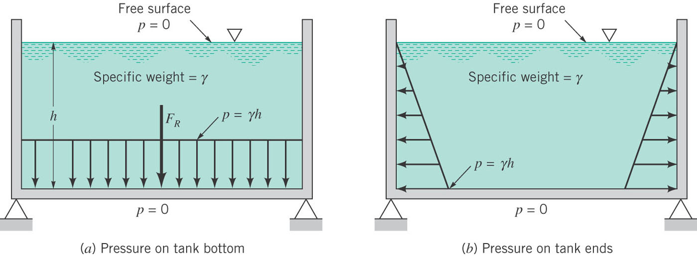
Here it is….
Uniform vs. varying with depth

Slide 17
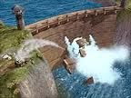
Consequences

Slide 18
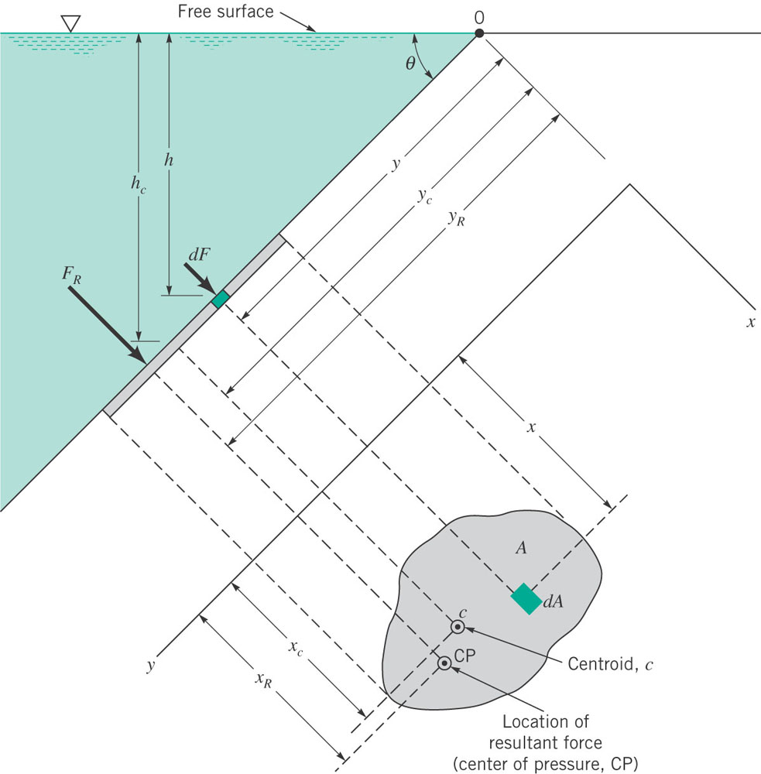
Pressure on an Inclined Plane

Slide 19
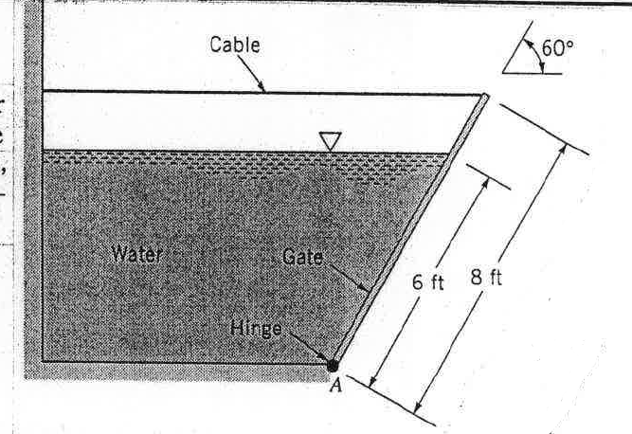
Sample Problem
A homogeneous, 4 ft wide, 8-ft long rectangular gate weighing 800lb is held in place by a horizontal flexible cable (see figure). Water acts on the gate, hinged at point A. Friction in the hinge is negligible. Determine the tension in the cable.

Slide 20
Concept of Hydraulic Lift
Apply a small force
Get big force
How?
A
B

Slide 21
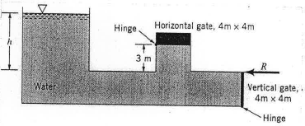
Sample Problem 2
When water depth h=5m it is desired that both gates open simultaneously. Determine the weight of the horizontal gate and the horizontal force on the vertical gate needed to keep them closed until this happens. The vertical gate has negligible weight. Friction effects are negligible too.

Slide 22
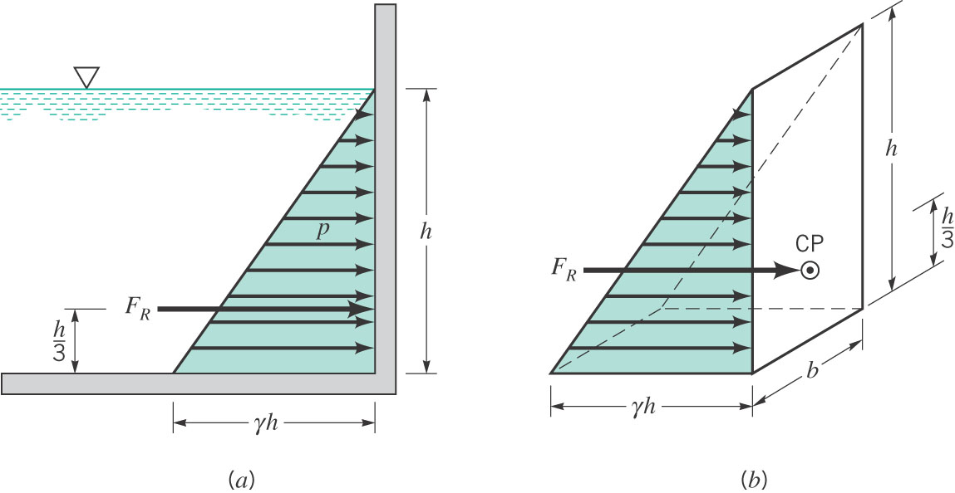
Pressure Prism

Slide 23
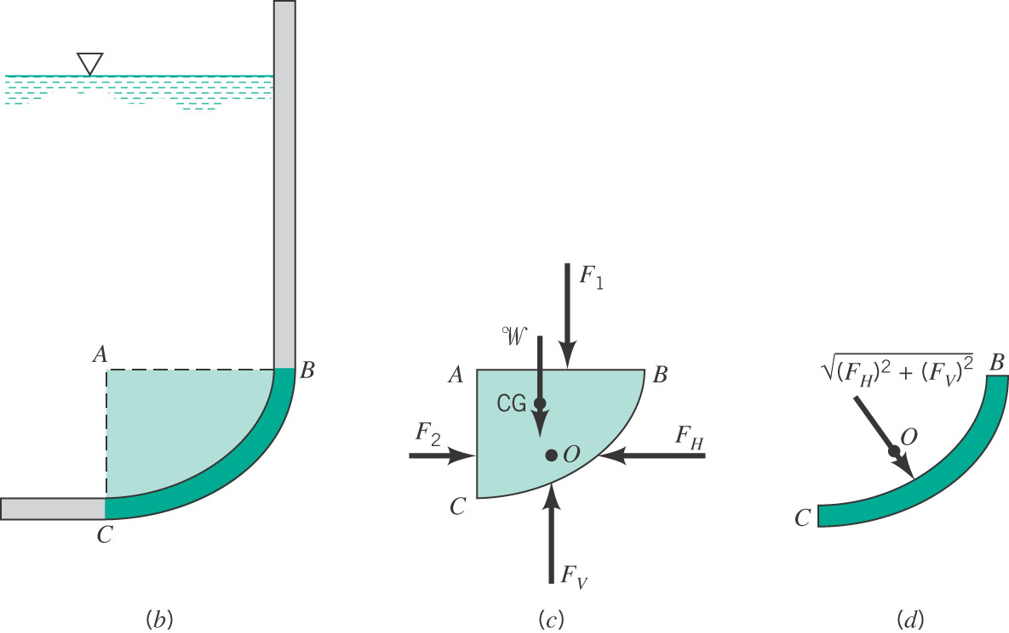
Curved Surfaces

Slide 24
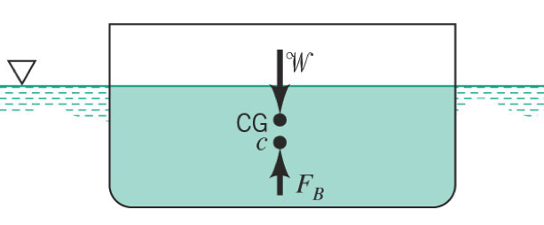
Archimides Principle

Slide 25
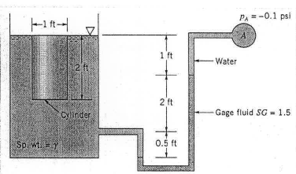
Sample Problem
A cylinder of 1ft diameter and 2 ft length contains a liquid of specific weight γ. A U-tube manometer is connected as shown. In figure the pressure in A is 0.1 psi below atmospheric. What is the weight of the cylinder, whose upper surface is flush with the fluid surface.

Slide 26
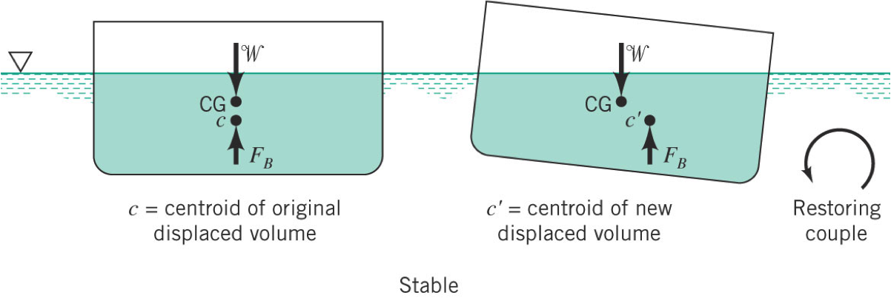
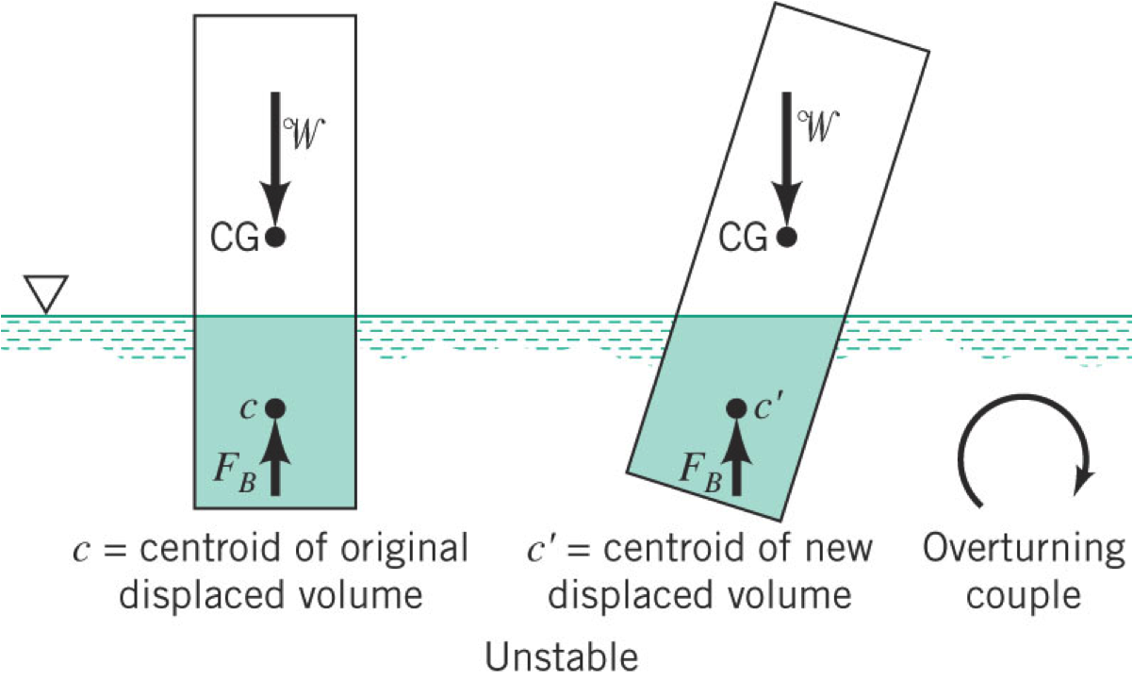
Stability
When in balance the centroid where total weight acts and buoyancy act are aligned
If not – rotational couple occurs
Can be stabilizing or destabilizing

Slide 27
Important Equations
dp/dz=-γ (pressure gradient in a stationary fluid)
F_{R}=γh_{c}A (hydrostatic force on a plane surface)
y_{r}=I_{xc}/y_{c}A+y_{c} x_{r}=I_{xyc}/y_{c}A+x_{c} (Location of hydrostatic force on a plane)
F_{b}=γV_{disp} (buoyant force)

